Slide 1
Programming with Python
Day 12

Slide 2
Introduction to GIT
Version control is a system that records changes to a file or set of files over time so that you can recall specific versions later.
Any type of file on a computer can be placed under version control.

Slide 3
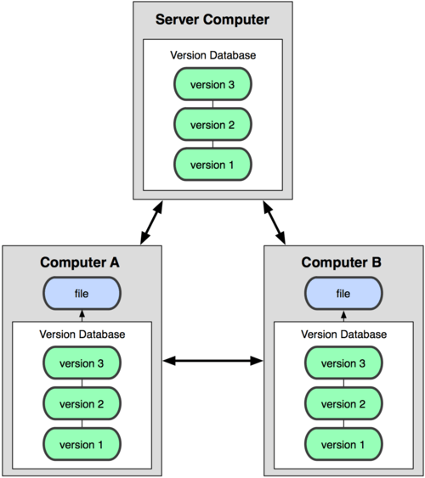
Types of Version Control system
Local
rcs
Centralized
CVS, Subversion
Distributed
Git

Slide 4
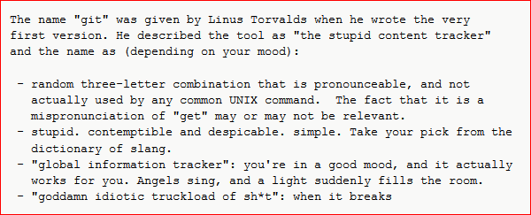
History of Git
In 2002, the Linux kernel project began using a proprietary DVCS system called BitKeeper. Then the relationship broke down.
Goals of the new DVCS:
Speed
Simple design
Strong support for non-linear development (thousands of parallel branches)
Fully distributed
Able to handle large projects like the Linux kernel efficiently (speed and data size)
Git was born in 2005
https://en.wikipedia.org/wiki/Git

Slide 5
Git Basics
The major difference between Git and any other VCS is the way Git thinks about its data. Conceptually, most other systems store information as a list of file-based changes. These systems (CVS, Subversion, Perforce, Bazaar, and so on) think of the information they keep as a set of files and the changes made to each file over time.
Git doesn’t think of or store its data this way. Instead, Git thinks of its data more like a set of snapshots of a miniature filesystem. Every time you commit, or save the state of your project in Git, it basically takes a picture of what all your files look like at that moment and stores a reference to that snapshot. To be efficient, if files have not changed, Git doesn’t store the file again, just a link to the previous identical file it has already stored. Git thinks about its data more like a stream of snapshots.
This is an important distinction between Git and nearly all other VCSs. It makes Git reconsider almost every aspect of version control that most other systems copied from the previous generation. This makes Git more like a mini filesystem with some incredibly powerful tools built on top of it, rather than simply a VCS.

Slide 6
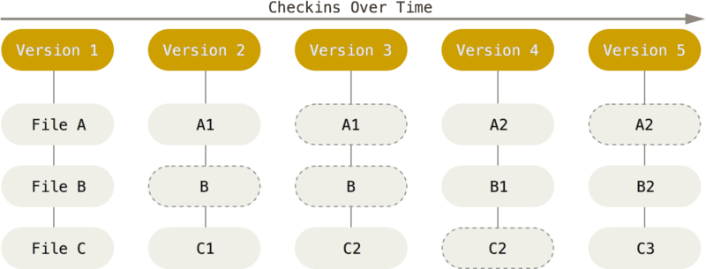
Git Basics

Slide 7
Git Basics: Local Operation
Most operations in Git only need local files and resources to operate – generally no information is needed from another computer on your network. If you’re used to a CVCS where most operations have that network latency overhead, this aspect of Git will make you think that the gods of speed have blessed Git with unworldly powers. Because you have the entire history of the project right there on your local disk, most operations seem almost instantaneous.
This also means that there is very little you can’t do if you’re offline or off VPN.

Slide 8
Git Basics: Integrity
Everything in Git is check-summed before it is stored and is then referred to by that checksum. This means it’s impossible to change the contents of any file or directory without Git knowing about it. This functionality is built into Git at the lowest levels and is integral to its philosophy. You can’t lose information in transit or get file corruption without Git being able to detect it.
Git stores everything in its database not by file name but by the hash value of its contents.
When you do actions in Git, nearly all of them only add data to the Git database. It is hard to get the system to do anything that is not undoable or to make it erase data in any way.
This makes using Git a joy because we know we can experiment without the danger of severely screwing things up.

Slide 9
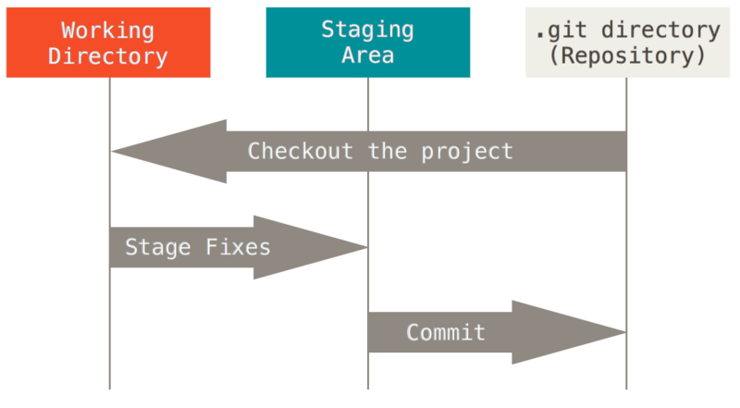
Git Basics: The Three States

Slide 10
Git Basics: The Three States
The Git directory (repo) is where Git stores the metadata and object database for your project. This is the most important part of Git, and it is what is copied when you clone a repository from another computer.
The working directory is a single checkout of one version of the project. These files are pulled out of the compressed database in the Git directory and placed on disk for you to use or modify.
The staging area is a file, generally contained in your Git directory, that stores information about what will go into your next commit. It’s sometimes referred to as the “index”, but it’s also common to refer to it as the staging area.
The basic Git workflow goes something like this:
You modify files in your working directory.
You stage the files, adding snapshots of them to your staging area.
You do a commit, which takes the files as they are in the staging area and stores that snapshot permanently to your Git directory.
If a particular version of a file is in the Git directory, it’s considered committed. If it has been modified and was added to the staging area, it is staged. And if it was changed since it was checked out but has not been staged, it is modified.

Slide 11
Command Line
There are a lot of different ways to use Git. There are the original command line tools, and there are many graphical user interfaces of varying capabilities.
Git command line is one of the most popular tools.

Slide 12

Exercise
Download and install Git for Windows from
https://git-for-windows.github.io/ (command line only)
http://windows.github.com (command line and GUI)
Set up your global configuration
… as well as your preferred source code editor, e.g.:
git config --global core.editor "'C:/Program Files (x86)/Notepad++/notepad++.exe' -multiInst -nosession"
Use the following command to check your global configuration:
git config –list
Check git help using this command:
git help <verb>

Slide 13

Getting a Git Repository
Initializing a repository in existing directory
Navigate to your project directory and execute the initialization command:
git init
This creates a new subdirectory named .git that contains all of your necessary repository files – a Git repository skeleton.
If you want to start version-controlling existing files (as opposed to an empty directory), you should begin tracking those files and do an initial commit. You can accomplish that with a few “git add” commands that specify the files you want to track, followed by a “git commit”

Slide 14

Cloning an Existing Repository
If you want to get a copy of an existing Git repository – for example, a project you’d like to contribute to – the command you need is git clone. If you’re familiar with other VCS systems such as Subversion, you’ll notice that the command is "clone" and not "checkout". This is an important distinction – instead of getting just a working copy, Git receives a full copy of nearly all data that the server has. Every version of every file for the history of the project is pulled down by default when you run git clone. In fact, if your server disk gets corrupted, you can often use nearly any of the clones on any client to set the server back to the state it was in when it was cloned.

Slide 15
Recording Changes to a Repository
You have a bona fide Git repository and a checkout or working copy of the files for that project. You need to make some changes and commit snapshots of those changes into your repository each time the project reaches a state you want to record.
Remember that each file in your working directory can be in one of two states: tracked or untracked. Tracked files are files that were in the last snapshot; they can be unmodified, modified, or staged.

Slide 16
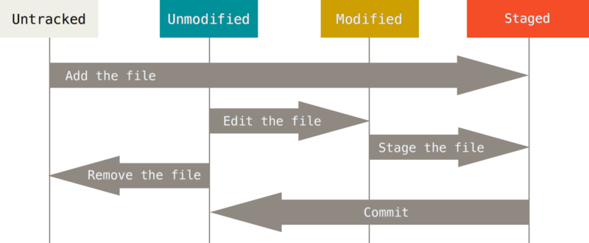
Recording Changes to a Repository

Slide 17

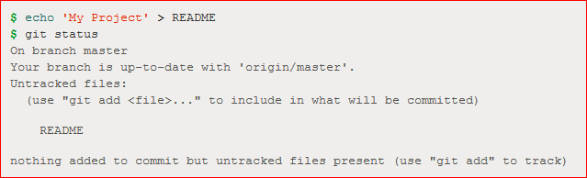
Checking the Status of Files
The main tool you use to determine which files are in which state is the “git status” command.

Slide 18
Tracking Files
In order to begin tracking a new file, you use the command “git add”.
“git add” is a multipurpose command – you use it to begin tracking new files, to stage files, and to do other things like marking merge-conflicted files as resolved. It may be helpful to think of it more as “add this content to the next commit” rather than “add this file to the project”.
If you modify a file, run “git add” again.
If you run “git status –s” or “git status --short" you get a far more simplified output from the command.
A – added
M – modified
?? – untracked

Slide 19
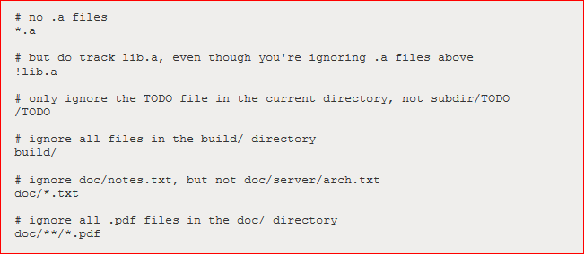
Ignoring Files
Use the .gitignore file to configure file patterns that should be ignored by Git (e.g. log files)

Slide 20
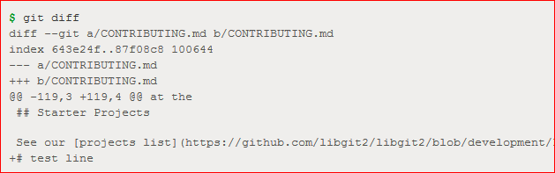
Viewing Staged and Unstaged Changes
If you want to know exactly what content has changed, not just which files were changed – you can use the “git diff” command.
“git diff” by itself doesn’t show all changes made since your last commit – only changes that are still unstaged.

Slide 21
Committing Changes
Remember that anything that is still unstaged – any files you have created or modified that you haven’t run “git add” on since you edited them – won’t go into commit.
Use the “git commit” command to commit changes.
Doing so launches your editor of choice.
The default commit message contains the latest output of the “git status” command commented out and one empty line on top.
Remember that the commit records the snapshot you set up in your staging area. Anything you didn’t stage is still sitting there modified; you can do another commit to add it to your history. Every time you perform a commit, you’re recording a snapshot of your project that you can revert to or compare to later.
If you want to skip the staging area, Git provides a simple shortcut. Adding the -a option to the git commit command makes Git automatically stage every file that is already tracked before doing the commit, letting you skip the git add part.

Slide 22

Removing Files from Git
To remove a file from Git, you have to remove it from your tracked files (more accurately, remove it from your staging area) and then commit. The “git rm” command does that, and also removes the file from your working directory so you don’t see it as an untracked file the next time around.
The next time you commit, the file will be gone and no longer tracked.
Git has a “mv” command to rename a file in Git:

Slide 23
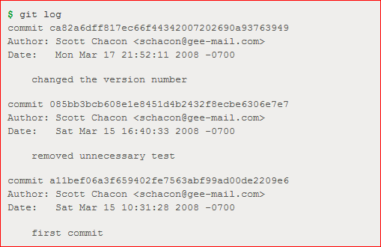
Viewing the Commit History
After you have created several commits, or if you have cloned a repository with an existing commit history, you’ll probably want to look back to see what has happened. The most basic and powerful tool to do this is the “git log” command.
Example: git clone https://github.com/schacon/simplegit-progit
git log

Slide 24

Undo
One of the common undos takes place when you commit too early and possibly forget to add some files, or you mess up your commit message. If you want to try that commit again, you can run commit with the --amend option:
git commit --amend

Slide 25
Working with Remotes
To see which remote servers you have configured, you can run the git remote command. It lists the shortnames of each remote handle you’ve specified.
To add a new remote Git repository as a shortname you can reference easily, run “git remote add <shortname> <url>”
If you want to fetch all the information that remote repository has but that you don’t yet have in your repository, you can run
git fetch <remote-name>
It fetches any new work that has been pushed to that server since you cloned (or last fetched from) it. It’s important to note that the “git fetch” command only downloads the data to your local repository – it doesn’t automatically merge it with any of your work or modify what you’re currently working on.
When you have your project at a point that you want to share, you have to push it upstream. The command is
git push [remote-name] [branch-name]
This command works only if you cloned from a server to which you have write access and if nobody has pushed in the meantime.

Slide 26
Tagging
Git has the ability to tag specific points in history as being important. Typically people use this functionality to mark release points (v1.0, and so on).
Listing the available tags in Git is straightforward:
git tag
Git uses two main types of tags: lightweight and annotated.
A lightweight tag is very much like a branch that doesn’t change – it’s just a pointer to a specific commit.
Annotated tags, however, are stored as full objects in the Git database. They’re checksummed; contain the tagger name, email, and date; have a tagging message; and can be signed and verified with GNU Privacy Guard (GPG). It’s generally recommended that you create annotated tags so you can have all this information; but if you want a temporary tag or for some reason don’t want to keep the other information, lightweight tags are available too.
Creating an annotated tag in Git is simple:
git tag -a v1.4 -m "my version 1.4“
To create a lightweight tag, don’t supply the -a, -s, or -m option:
git tag v1.4-lw

Slide 27

Git Aliases
If you don’t want to type the entire text of each of the Git commands, you can easily set up an alias for each command using git config. Here are a couple of examples you may want to set up:

Slide 28
Exercise
Sign up for a Bitbucket account at https://bitbucket.org/account/signup/
Complete the Bitbucket/Git tutorial from https://www.atlassian.com/git/tutorials/learn-git-with-bitbucket-cloud

